Slide 1


Marketing Analytics using Social Media
Vrushali Sawant, Sri Harsha Degala, Laxmi Narayana Atluri, Freddy Cabrera

Slide 2
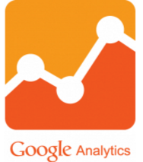




Project Goals
Goal | Technique | Tools | Data Source
Trends in social media activity | Visual Analytics | Tableau, R
Cause effect relationship between social media awareness and registrations | Text clustering, Text Topic modeling, Linear Regression | SAS Enterprise Guide, SAS Enterprise Miner
Cause effect relationship between marketing / branding activities on donations | Time Series analysis | Base SAS, SAS Enterprise Guide | Donor Perfect data

Slide 3
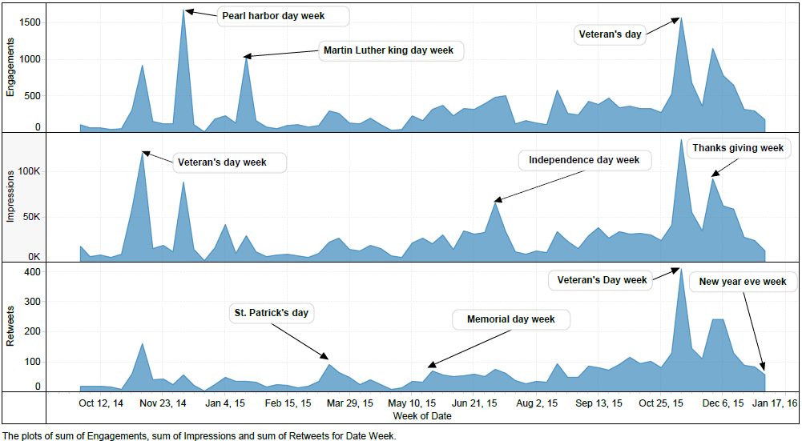
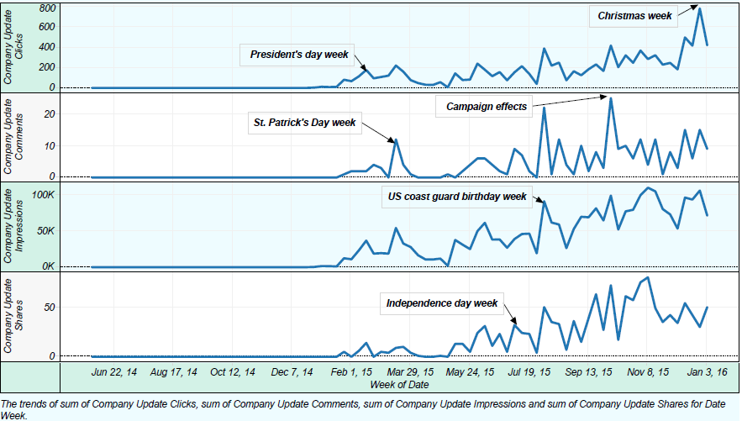

Trends in Hire Heroes Social Media Activity
Twitter data weekly trend
LinkedIn data weekly trend
Social Media Interactions -> More on Patriotic days/ Holidays
-> Campaigns related to registrations and professional development
Twitter data: WordCloud

Slide 4
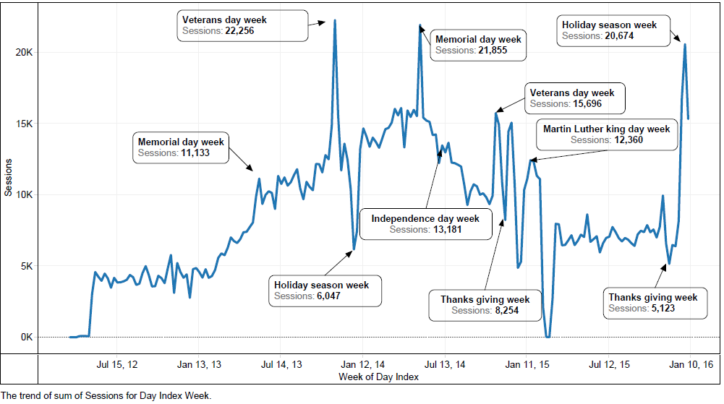




Trends in Hire Heroes Website Activity
Browser | New Users | Pages/Session | Average Load Time | Bounce Rate
 | 1.56M | 2.43 | 11.07 | 0.34
 | 1.49M | 3.89 | 5.73 | 0.15
 | 800K | 2.68 | 8.82 | 0.26
 | 534K | 2.87 | 8.02 | 0.21
Google analytics: Browser Specific Data
Google analytics session weekly trend
The Average Page Load time is 11.46s ranging between 40s to 2 mins during special days
Load time trend since 2012 to 2016
/get-registered page has 2nd highest entrances but it has a bounce rate of 91%
73% of sessions last for <10s, 14% lasts 1min to 10 mins

Slide 5
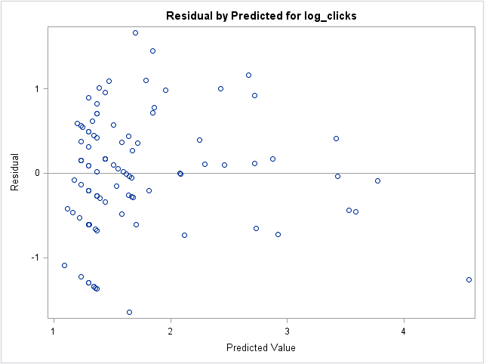
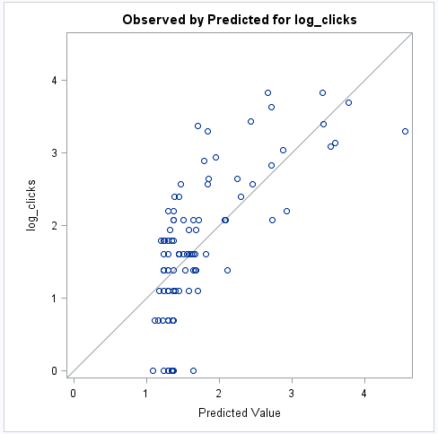
Cause Effect: Social Media on Registrations
Dependent variable: log(Clicks)
Parameter | Estimate
Retweets | 0.06970
likes | 0.014
likes | 0.05083
R-Square Value: 0.49
Linear Regression output
Residual vs Predicted plot
Observed vs Predicted plot
data where campaign value is “Registration” is used for analysis
Model shows that social media does have an effect on registration and explains about 50% of variation in the data
retweets, likes, likes are significant with 0.05 p-value
Residual vs Predicted plot above shows random distribution of error
Dependent variable against the predicted values show that the predicted value was closer to actual values indicating accuracy of model
Note: Assumption that a person who clicks the link related to registration on Hubspot is likely to register on Hire Heroes website. Not allowed to use Salesforce for Registrant data

Slide 6
Cause Effect: Facebook Campaign on Registrations & Donations
Dependent variable: Lifetime clicks
Text parsing
Parameter | Estimate
Donations | 1.1903
Post Consumers | 0.6482
Post Consumptions | 0.3719
Talking about post | 0.3189
Total reach | 0.005
Engaged Users | -0.2923
R-Square Value: 0.8538
Text Filter
Text Cluster
Text Topic
Variable selection
Regression
Process Flow for Facebook Post data 2014-16 analysis
Parameter estimates and Linear regression output
Text clustering: Donations and Registrations clusters were formed using text clustering of post data
Text topic: The terms from clusters were used to generate user topics for Donations and Registrations
Variable Selection: 14 variables were selected using R-squared criterion in SAS
Our model explains ~85% of variation in the data
Our analysis reveals that is having a positive impact on creating awareness about donations rather than registrations
Note: Assumption that a person who clicks the link on Facebook is likely to register or donate on Hire Heroes website. Not allowed to use Salesforce for Registrant data

Slide 7
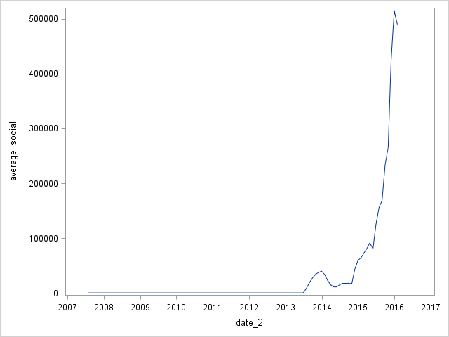
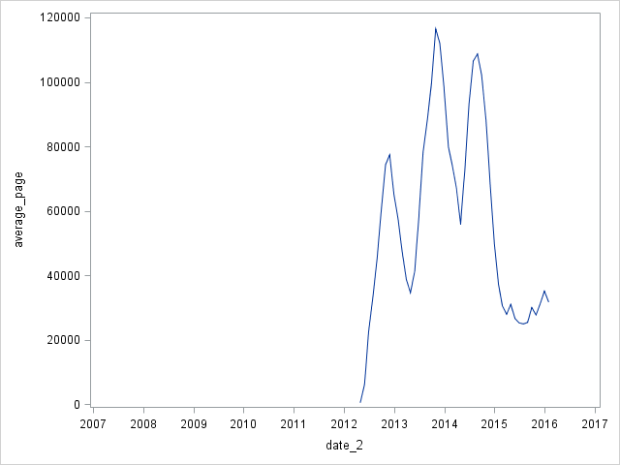
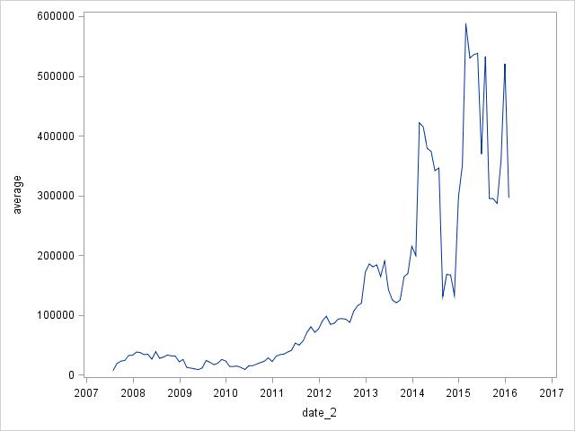
Cause effect relationship between marketing / branding activities on donations
Data Source | Attributes
Post | Date, Shares, Comments, Likes, Total Reach/Impressions/Engaged Users
Page | Date, Page New Likes, Page Unlikes, Page Engagements
 | Date, Likes, Comments, Shares, Clicks, Impressions
 | Date, Likes, Comments, Shares, Clicks, Impressions
 | Date, Page Views
Donor Perfect | Date, Amount Donated
6 Month Moving Average Social All
6 Month Moving Average Page Views
Attributes of Integrated dataset
6 month moving average to correct for potential seasonal fluctuations in the dataset
Log Transformations for 6 month moving average to deal with outliers
Linking datasets: Date variable
Consolidated New Attributes: Aggregating
to create Social Media variables
Amount donated: 6 Month Moving Average

Slide 8
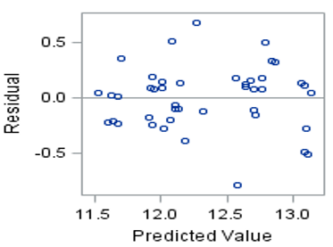
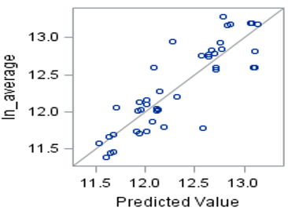
Cause effect relationship between marketing / branding activities on donations
Dependent Variable: Log(6-Month Average Donated Amount)
Parameter | Estimate
Log_Average_Social | 0.02797
Lag_Log_Average_Amount_Donated | 0.65208
R-Square Value: 0.7538
Time Series multi linear regression output
Residual vs Predicted plot
Observed vs Predicted plot
The model shows that did not significantly help bring in more donations
1% in social media interaction leads to a 0.02% in the 6 month moving average in donations
Model explains 75% of the variability in Average amount donated
Auto regressive term (Lag_ln_Average), helps us to capture effect of channels other than social media on donations
Residual vs Predicted plot above shows random distribution of error
Dependent variable against the predicted values show that the predicted value was closer to actual values indicating accuracy of model

Slide 9

Recommendations
can be used to drive more “Registrations”
can be used for generating awareness about “Donations”
Run “Donation Campaigns” independent of Social Media
Scalable Cloud Services to host website
Improve browser specific website code for more efficiency
Redesign “/get-registered page” to reduce Bounce rate
Notes:
Optimizing website design: https://blog.crazyegg.com/2013/12/11/speed-up-your-website/

Slide 10
vsawant@uncc.edu
vrushuuu
D5

